Slide 1
CME 502
FINAL RPOJECT PRESENTATION
PRESENTED BY: AMNA SALEEM
PRESENTED TO: PROF. NAV. NIDHI
Storage and transportation of 20 MW Hydrogen using Methyl-cyclohexane LOHC by the process of Vapor Phase Hydrogenation of Toluene

Slide 2
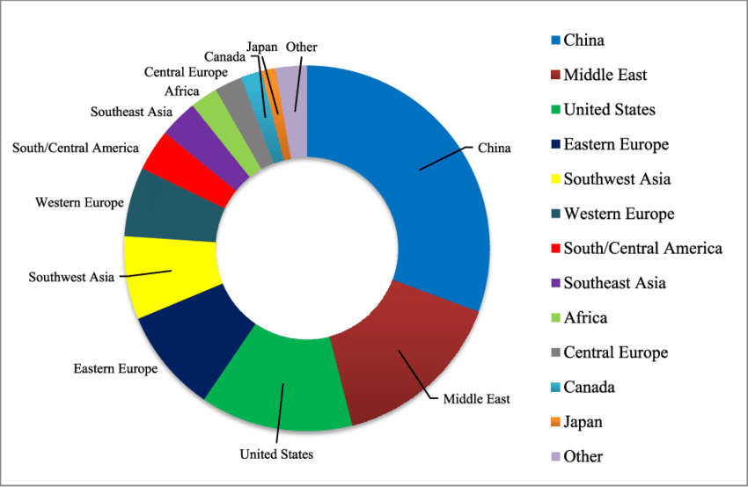
Hydrogenation of Toluene to Methylcyclohexane (MCH)
Background & Motivation
Current fuels cause pollution & are unsustainable.
Hydrogen: clean, renewable energy carrier (not a fuel itself).
Challenge: hydrogen production, storage, and transport.
Project Objective
The primary objective of this project was to design and optimize a hydrogenation process for converting toluene to methylcyclohexane, and using AI-driven cost prediction to enhance scalability, efficiency, and economic feasibility for future hydrogen storage systems.
Why MCH:
Hydrogenate toluene → MCH, a safer and more valuable liquid.
MCH is non-carcinogenic, stable, non-volatile, unlike toluene.
2017 world consumption of hydrogen according to IHS Markit’s 2019 Chemical Economics Handbook report on Hydrogen.
Key Properties
MCH: saturated, stable, hydrophobic, effective solvent.
Ideal for reaction medium & fuel applications.

Slide 3
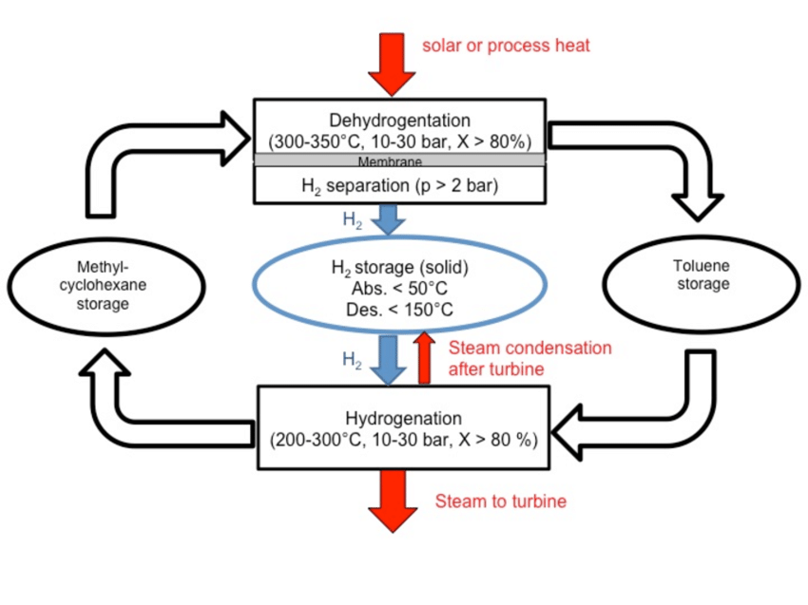
Introduction
Are there any hurdles in establishing hydrogen supply chain?
hydrogen has the largest flammability limits (4-74%) in air by volume at ambient conditions as compared to other fuels.
it has very low energy barrier for combustion in air, i.e., the minimum ignition energy of 0.017 mJ.
As a cryogenic liquid, it has an extremely low normal boiling point (~20.4 K), high thermal conductivity (~0.1 W/m/K) and high latent heat (448.7 kJ/kg) which in combination can easily lead to frostbite/cold burns
largest liquid to vapor volume expansion ratio
occupies 860 times higher volume in gas phase at ambient conditions compared to that at liquid phase at ambient pressure.
Thus, if LH2 is left confined in a sealed vessel, its expansion can cause significant pressure to build up.
Requires much larger vessels to store equivalent amount of energy compared to other fuels.
All these characteristics add to many challenges to establish national/ international hydrogen supply chain.
Schematic of the methylcyclohexane-toluene-hydrogen system.
Process Overview
Hydrogenation is a chemical reaction that involves the addition of hydrogen (H2) to a compound, typically in the presence of a catalyst, to form a saturated product
Reaction Mechanism
Step 1: Adsorption
Step 2: Hydrogen Dissociation
Step 3: Surface Reaction
Step 4:Recombination
Step 5: Desoprtion

Slide 4
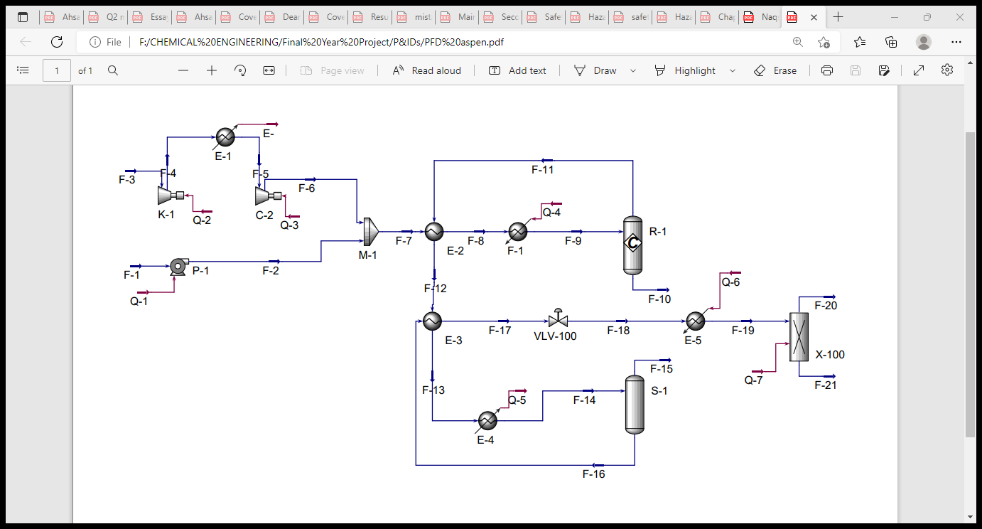
Simulation on ASPEN HYSYS
Reactor Inlet Conditions:
Fresh Feed Temperature H₂ = 25 C
Fresh Feed Temperature toluene = 25 C
Reaction Temperature = 220 C
Hydrogen Gas Pressure = 13.5 bar
Hydrogen to feed molar ratio = 3.5:1
Production of Methylcyclohexane by hydrogenation of Toluene Simulated on ASPEN HYSES

Slide 5
Process Flow Description
F-1: Pure toluene feed at 1 bar & 25°C is pumped to 14.5 bar.
F-2: Pressurized toluene is mixed with hydrogen (F-3) at 14.5 bar & 25°C.
Molar ratio maintained at 3.5:1 (H₂:toluene).
F-4: Mixed stream is preheated to 200°C using reactor outlet (F-7) in heat exchanger E-1.
F-5 → F-6: Further heated to 220°C using saturated steam in heater E-2.
F-6 enters fixed-bed plug flow reactor at 220°C & 13.5 bar with catalyst for hydrogenation.
F-7: Reactor outlet stream returns to E-1 to preheat feed and cool itself.
F-8: Cooled to 142.9°C, then further cooled in E-3 to 37.8°C using cooling water (CW1-in).
F-9 enters phase separator S-1:
Top outlet (F-11): Unreacted hydrogen → compressed (K-1 & K-2) → recycled (F-14)
Bottom outlet (F-10): MCH + toluene + trace H₂
F-10: Pressure reduced to 1.4 bar via expansion valve (VLV-100).
F-15 enters distillation column D-1:
Top (F-16 & F-17): Hydrogen & MCH
Bottom (F-18): Recovered toluene

Slide 6
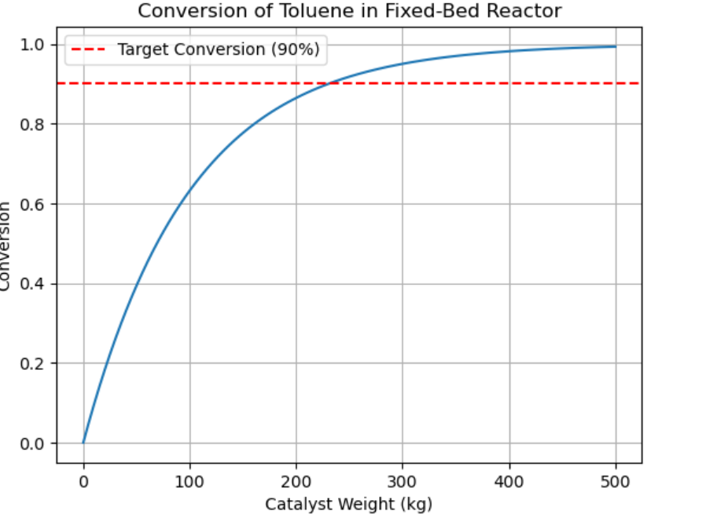
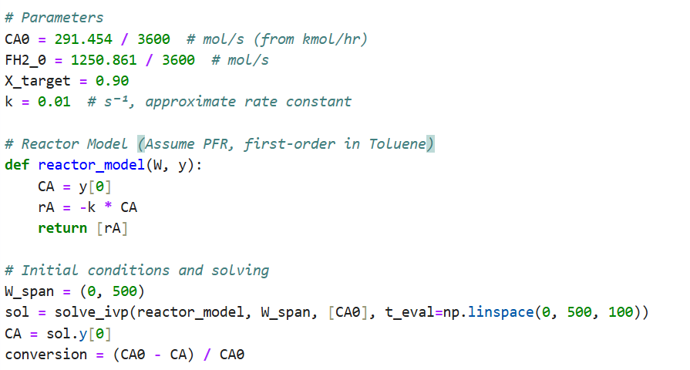
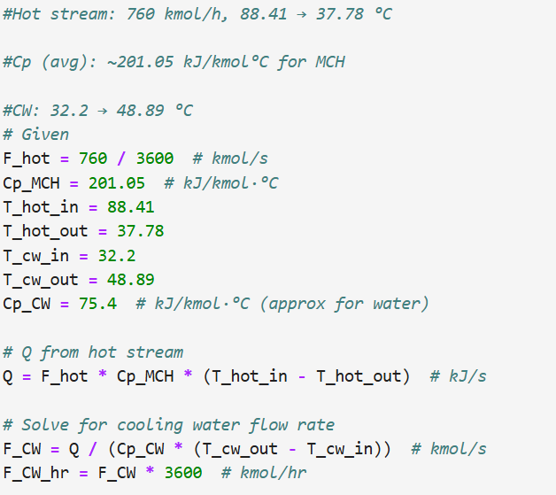
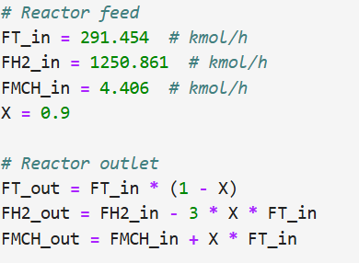
Conversion of toluene based on real data
Cooling water flowrate and outlet feed in kmol/hr
Required cooling water flow rate = 6147.49 kmol/hr
Toluene out: 29.15 kmol/h
Hydrogen out: 463.94 kmol/h
MCH out: 266.71 kmol/h

Slide 7
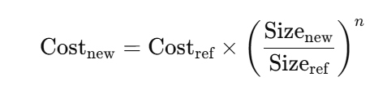
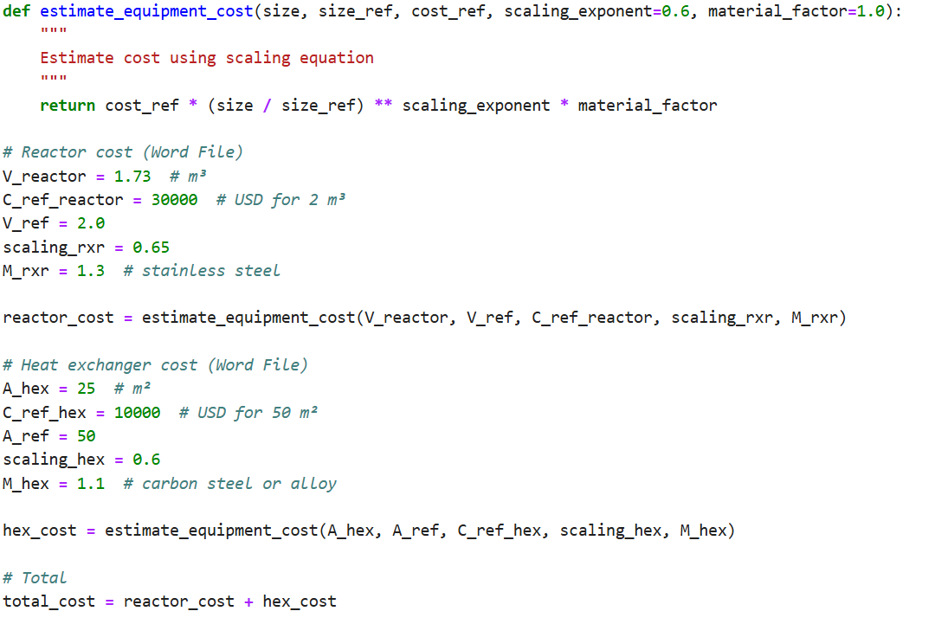
Python Code to Validate and Match Word-Based Cost Estimates:
Validated Cost Estimation
(Based on Word Report)
Reactor Cost: $35,491.56
Heat Exchanger Cost: $7,257.29
Total Estimated Equipment Cost: $42,748.85

Slide 8
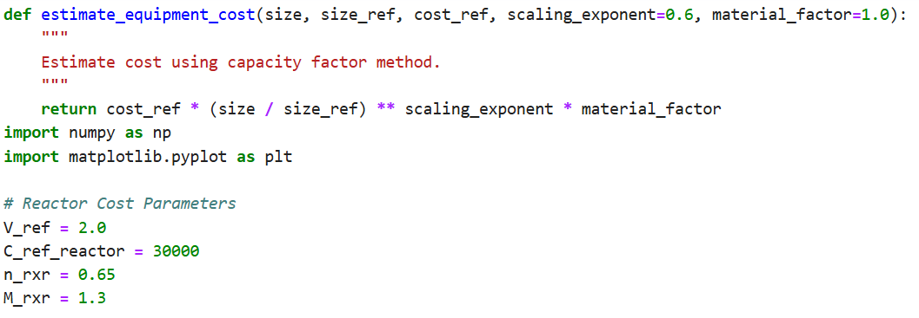
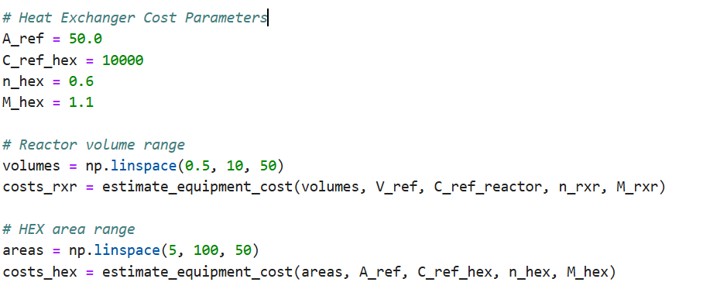
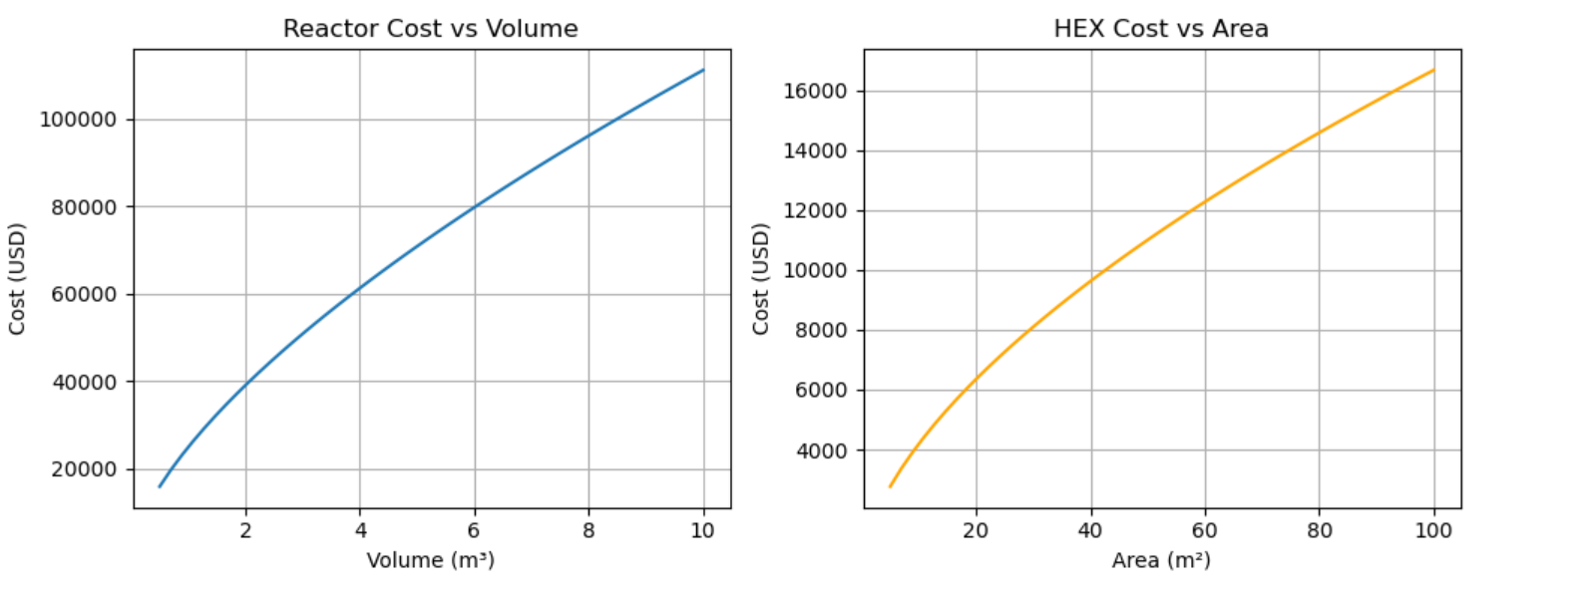
Equipment cost as the size increases

Slide 9
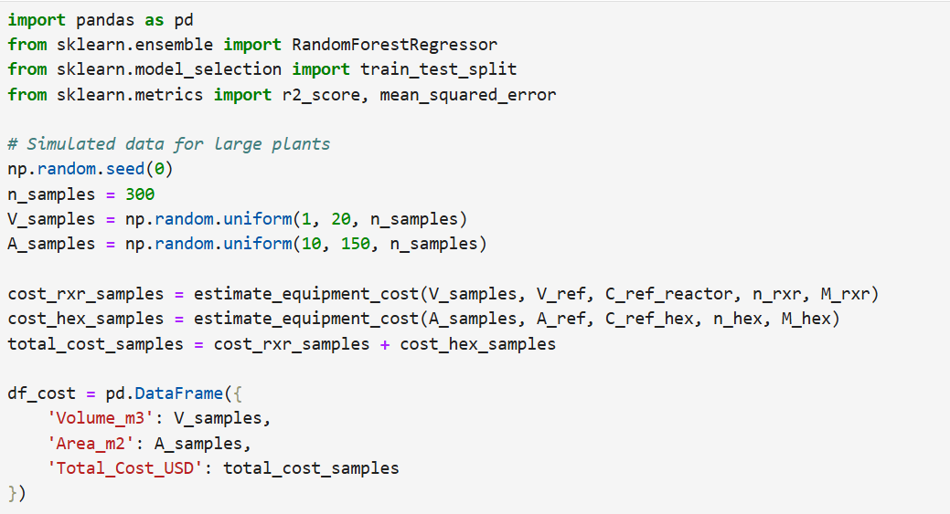

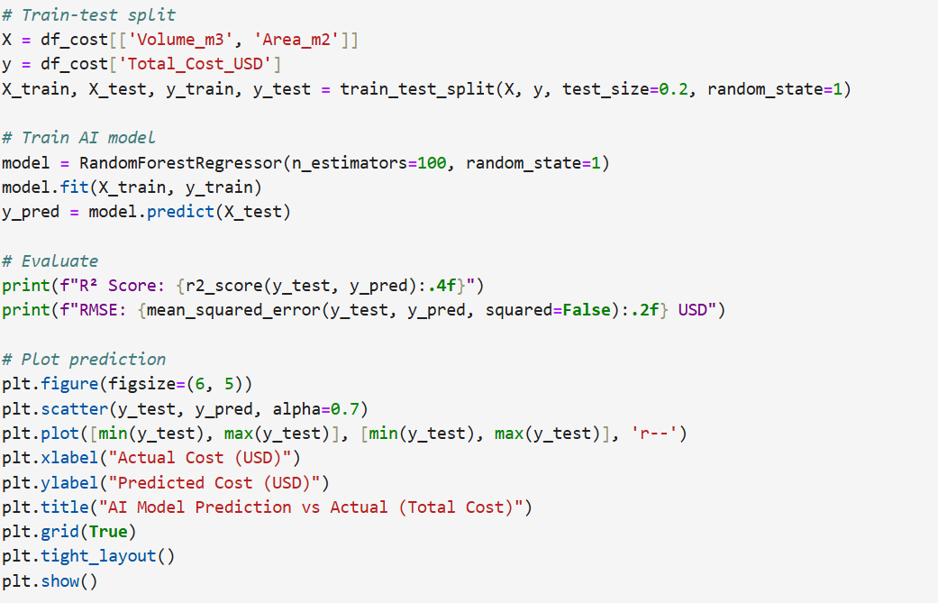
Generating data for plants plus Training and testing the AI Model to predict the impact on cost.
R² Score: 0.9977
RMSE: 1778.10 USD

Slide 10
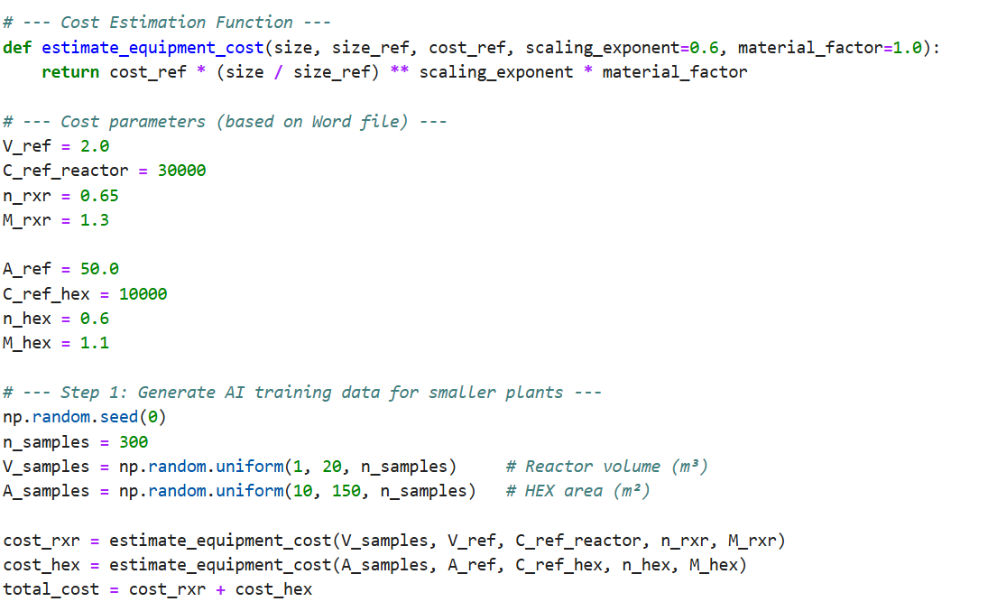
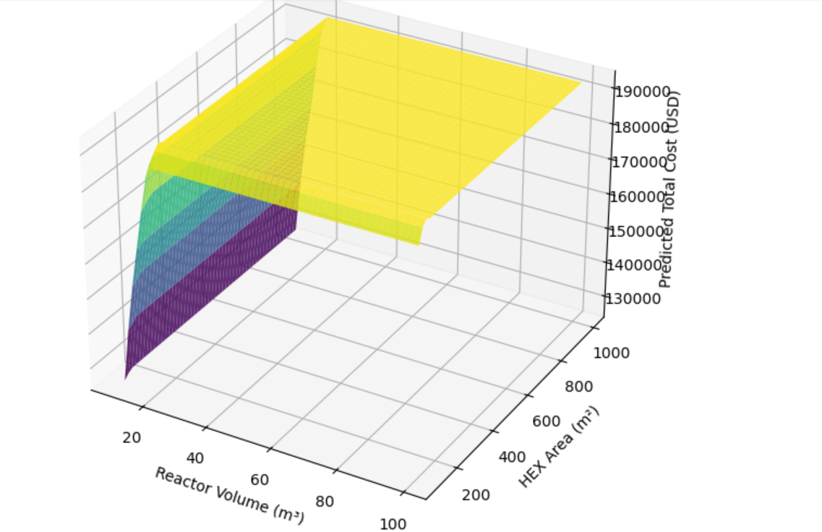
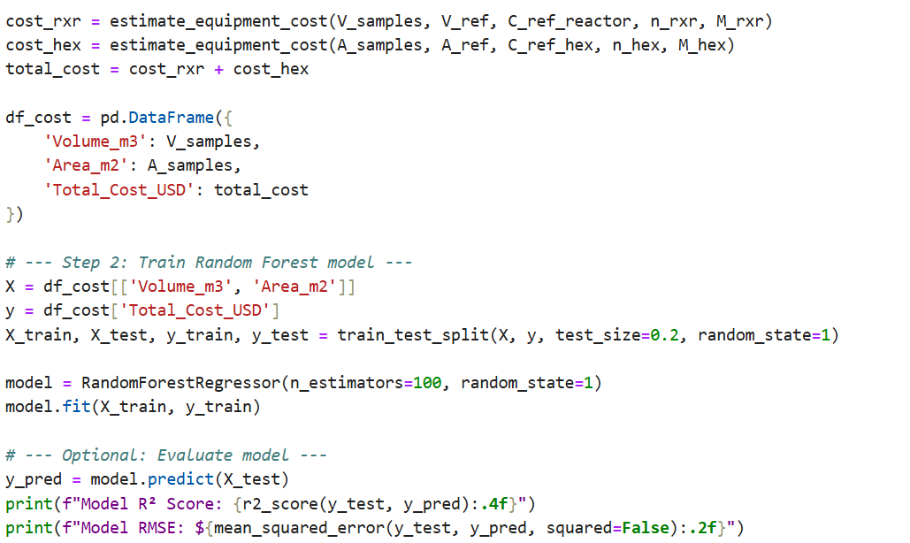
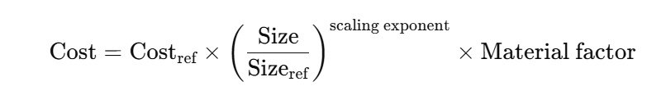
AI-Based Cost Simulation for Larger Hydrogenation Plants Cont.
Model R² Score: 0.9977 Model RMSE: $1778.10

Slide 11
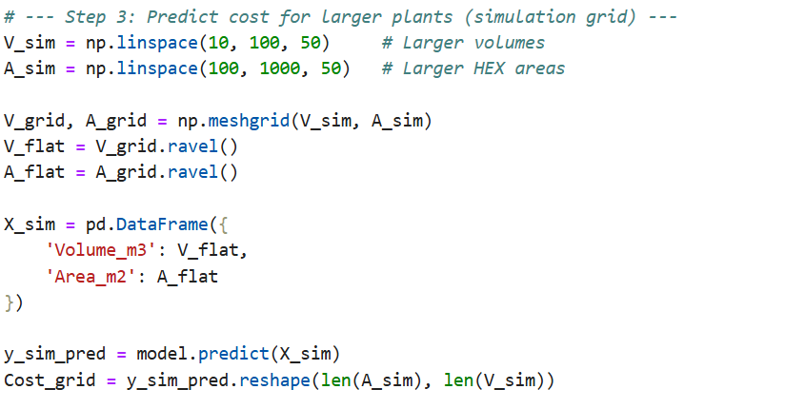
Continued…

Slide 12
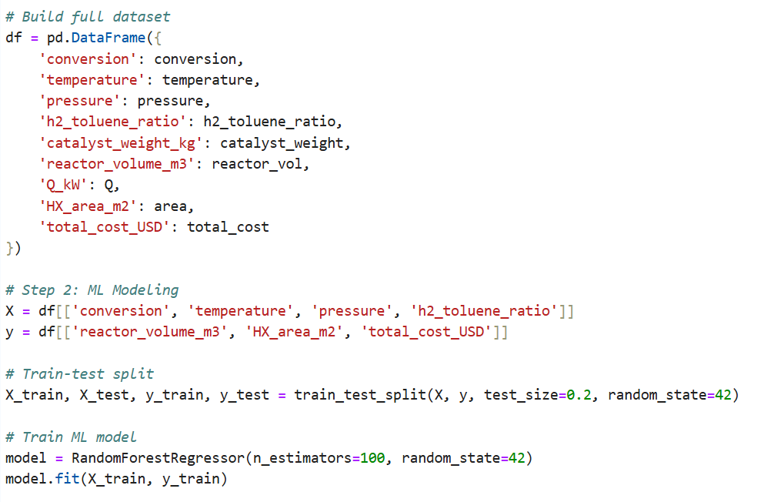
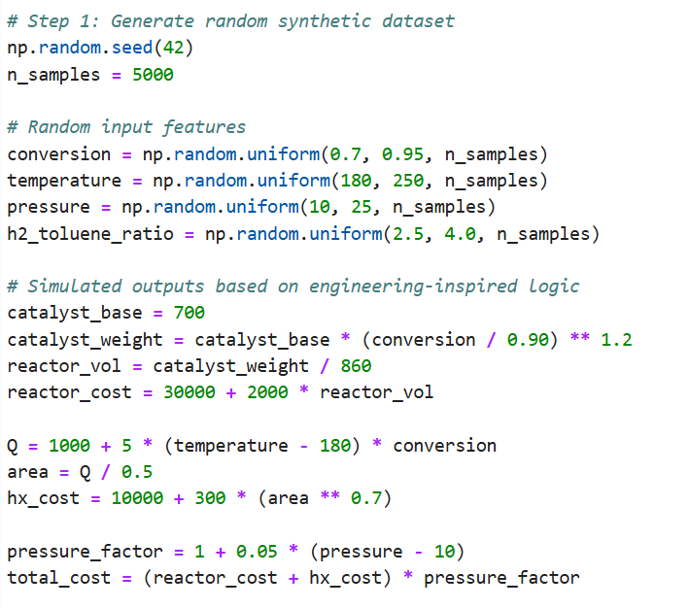
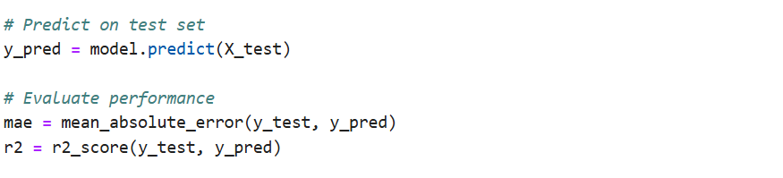
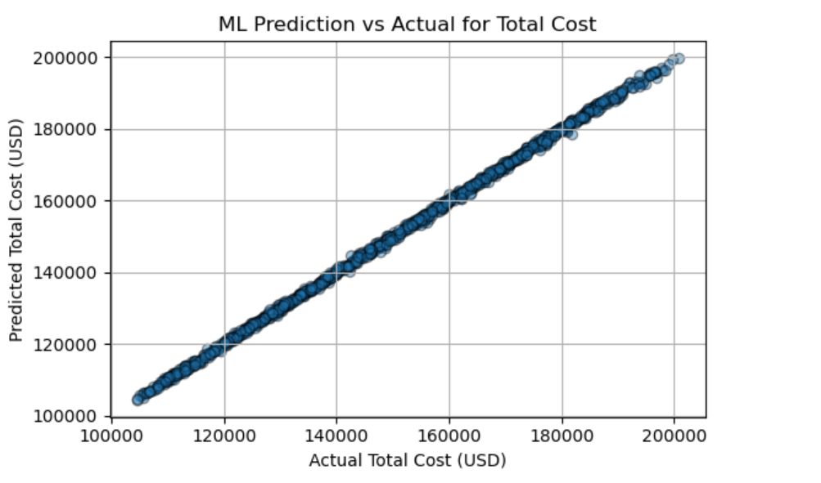
Code to assess model accuracy
Creating a synthetic dataset of 5000 samples with random input features to simulate realistic engineering outputs.
Mean Absolute Error = 160.275233
R2= 0.9107479

Slide 13
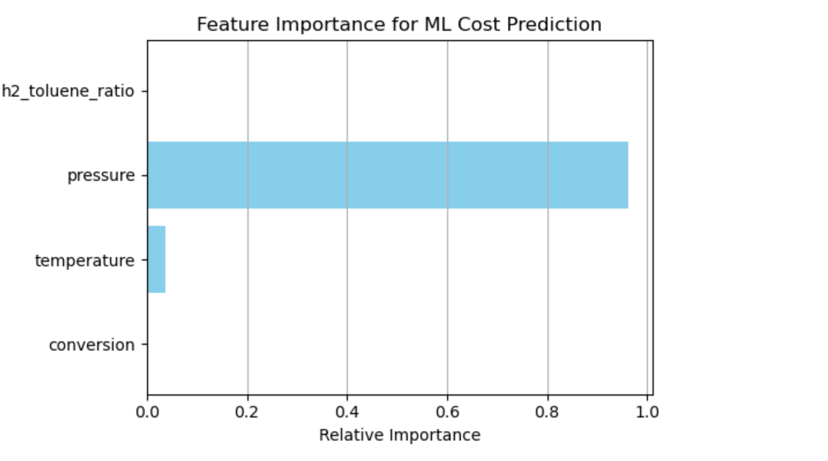
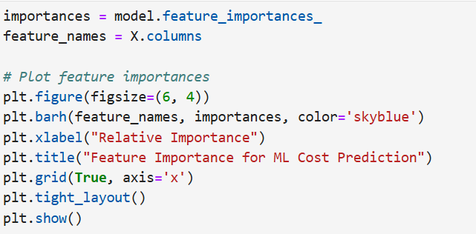
Features that affects the ML cost prediction

Slide 14
Thank You!
Questions OR Feedback?????

